Slide 1
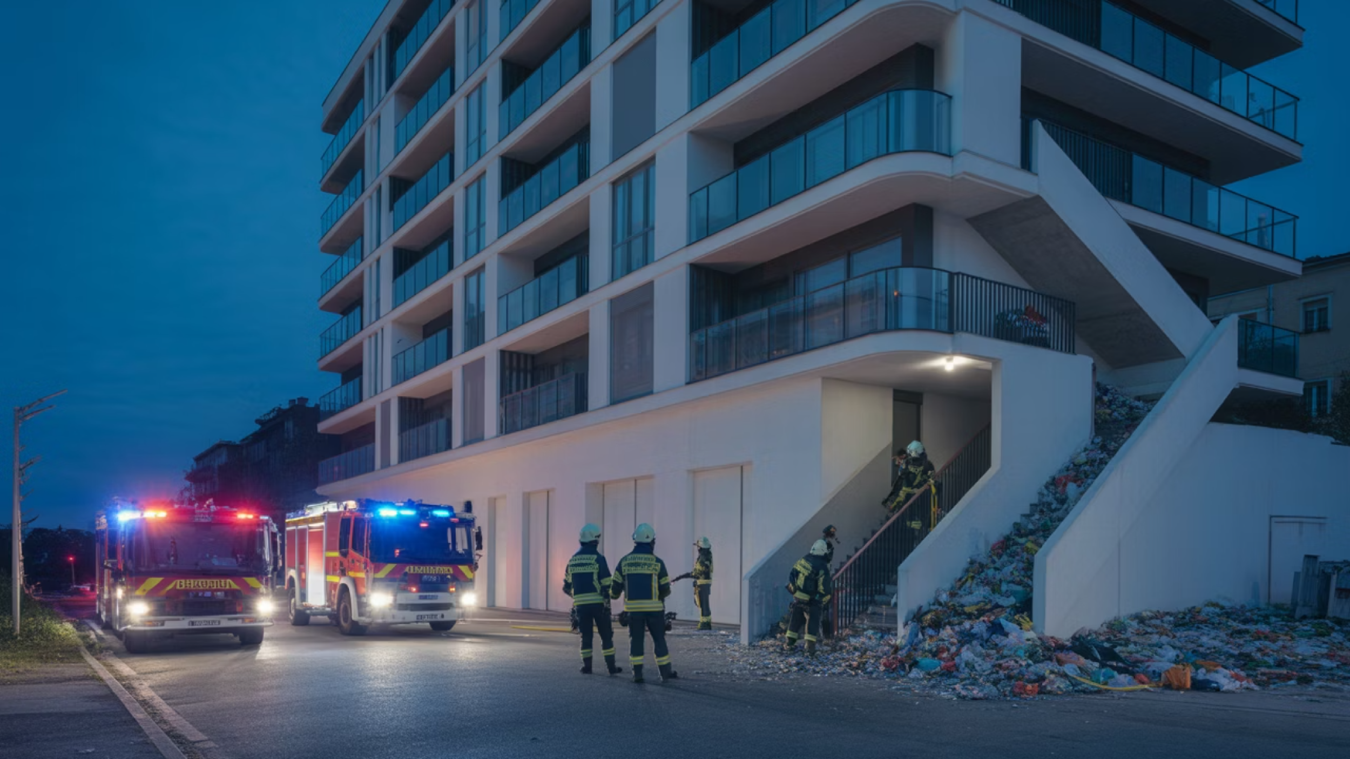
The Addison Fire Tragedy: Institutional Negligence and Cover-Up
This case study documents a catastrophic failure of public safety oversight that culminated in a preventable high-rise fire at the Addison on 4th Apartments in Seattle on January 7, 2020. The Seattle Department of Construction and Inspections (SDCI) systematically ignored multiple tenant complaints and Seattle Fire Department warnings about severe fire hazards created by a malfunctioning trash compactor. The evidence presented herein reveals not only a pattern of negligence but also suggests deliberate attempts by SDCI officials to cover up their failures through falsified inspection records. This investigation exposes critical breakdowns in municipal accountability that directly endangered residents' lives and raises serious questions about the integrity of Seattle's building safety enforcement system.

Slide 2
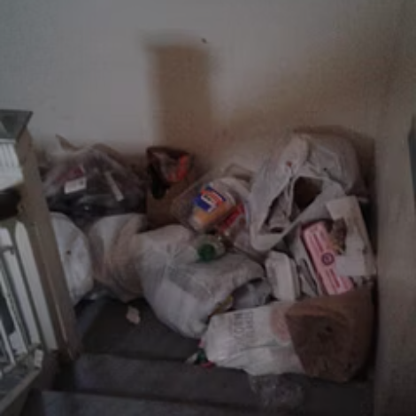
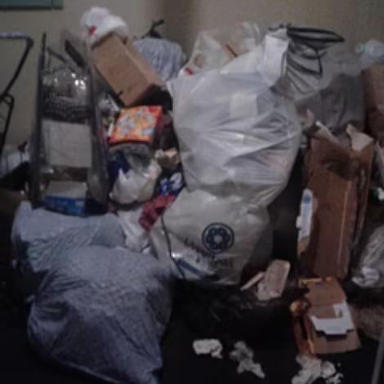
Background and Initial Warnings: A Crisis Ignored
The crisis at the Addison on 4th Apartments began in November 2019 when the Seattle Fire Department (SFD) filed an official complaint noting unsafe and unsanitary conditions throughout the building. On November 9, 2019, SFD personnel documented their concerns in complaint #010696-19CP, specifically highlighting "feces, needles, garbage, etc." in common areas throughout the building. The SFD explicitly stated they were "pursuing remedy through our code enforcement division but many of the problems are beyond our scope (Seattle Fire Code)" - a clear signal to SDCI that immediate intervention was required within their jurisdiction.
"Observed housing code violations incl., but not limited to: trash stored in stairwells & on lower rooftop; broken window glazing at (2) or more windows located in corridor elevator lobby; broken trash compactor resulting in trash chute backed up to 6th floor."
Despite documenting these severe violations, SDCI issued a Notice of Violation on December 16, 2019, with a compliance deadline of January 13, 2020 - a full 35 days after confirming hazardous conditions and more than two months after the initial SFD warning. This inexplicable delay in enforcement allowed dangerous conditions to persist and worsen, ultimately setting the stage for disaster just one week before the compliance deadline was to expire.
This warning from professional firefighters - individuals specifically trained to identify fire hazards - should have triggered immediate action from SDCI. Instead, it was met with bureaucratic delays and indifference. It wasn't until nearly a month later, on December 6, 2019, that SDCI Inspector Stephen Rudolph confirmed these violations during an inspection, noting:

Slide 3
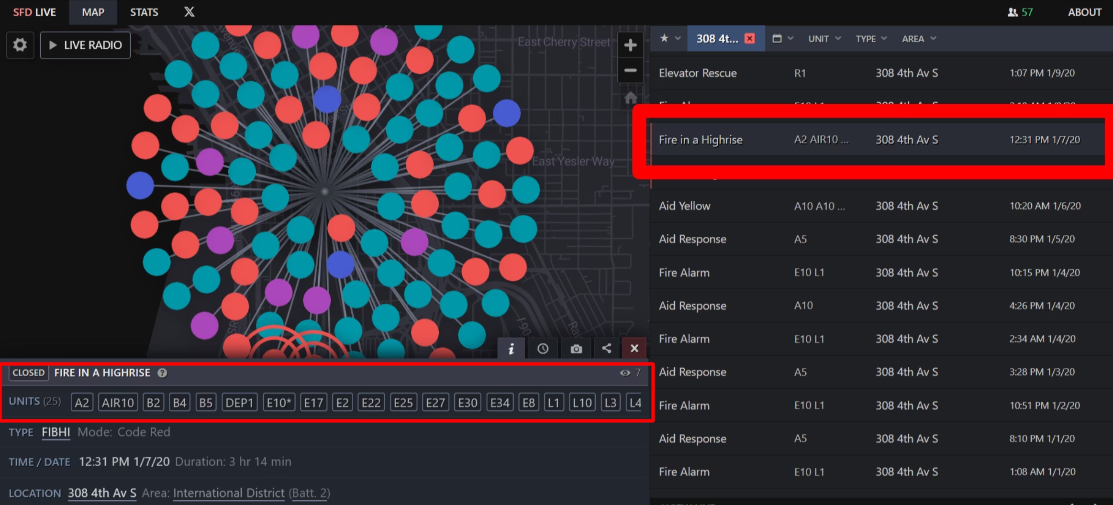

Slide 4
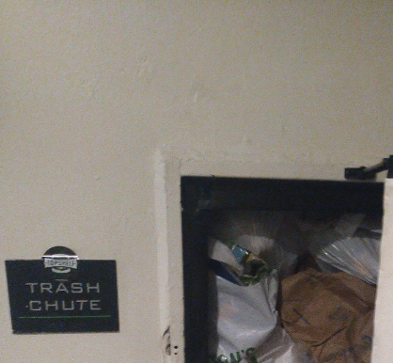
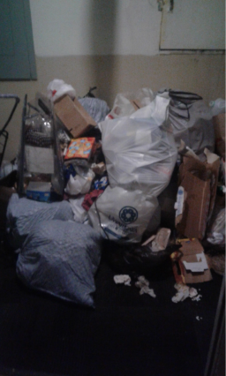
Timeline of Tenant Complaints and SDCI's Systemic Failure to Respond
Between late November 2019 and January 7, 2020, multiple tenants filed formal complaints with SDCI regarding increasingly hazardous conditions at the Addison. Each complaint was systematically dismissed without proper investigation or resolution, establishing a clear pattern of negligence:
November 9, 2019
1
Seattle Fire Department files initial complaint (#010696-19CP) warning of unsafe/unsanitary conditions in common areas throughout the building, including feces, needles, and garbage, urging SDCI to address issues within their jurisdiction.
2
December 6, 2019
Inspector Stephen Rudolph confirms violations, noting trash in stairwells, broken window glazing, and a broken trash compactor causing backup to the 6th floor. Despite documenting severe hazards, enforcement action is delayed.
December 16, 2019
3
SDCI issues Notice of Violation with compliance deadline of January 13, 2020—far too late given the severity of conditions already documented. No follow-up inspections are conducted despite continuing complaints.
4
5
December 26, 2019
Complaint #011787-19CP filed by tenants reporting three weeks of backed-up trash chutes with garbage attracting flies and rats. Assigned to Inspector Rudolph, who closes it as "ADMIN CLOSED" on January 6, 2020, without resolution.
December 30, 2019
6
January 2, 2020
Additional tenant complaint (#011867-19CP) notes trash uncollected for over three weeks with no resolution plan from management. Later "inspected" by Darren Wilson on January 30, 2020 (post-fire) and was able to mark it "No Violation Observed." because the Fire Department had taken care of the issue three weeks earlier..
Two more complaints (#000128-20CP, #000129-20CP) reiterate garbage chute broken for three weeks, creating unsanitary conditions and rat infestations. Both complaints administratively closed by Rudolph on January 6, 2020, without inspection.
January 6, 2020
7
Final complaint before fire (#000239-20CP) reports garbage piles in hallways, broken chute, human feces, and nightly fire alarms. Closed as "ADMIN CLOSED" on January 8, 2020, after fire had already occurred.
8
January 7, 2020
Trash chute ignites, resulting in a high-rise fire requiring 25 SFD units in a Code Red emergency response. The preventable disaster validates tenant concerns that had been systematically ignored by SDCI for months.
This chronology reveals not merely isolated incidents of oversight, but a systematic pattern of negligence and abdication of duty by SDCI. Most egregiously, Inspector Stephen Rudolph administratively closed multiple complaints on January 6, 2020—just hours before the fire—without conducting proper inspections or ensuring resolution of the documented hazards.

Slide 5
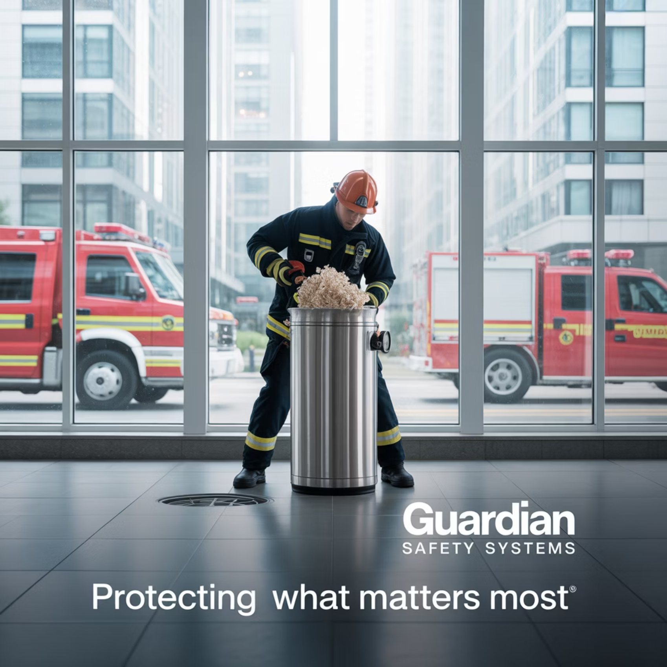

The Fire: Culmination of Negligence and Regulatory Failure
i think we should put the lawsuit here
On January 7, 2020, the worst-case scenario that tenants and the Seattle Fire Department had been warning about for months finally materialized. The overflowing trash chute that had been reported in at least seven separate complaints ignited, causing a high-rise fire that triggered a Code Red emergency response requiring 25 Seattle Fire Department units to extinguish the blaze and clear the chute of hazardous waste.
The severity of this emergency response highlights the magnitude of the disaster that SDCI's negligence had allowed to develop. A Code Red designation represents the highest level of emergency response and indicates a situation with potential for mass casualties and catastrophic property damage. That such a response was necessary underscores the gravity of SDCI's failure to enforce basic housing and fire safety codes.
The fire validated the specific concerns repeatedly raised by tenants in their complaints - particularly that the accumulated garbage created a severe fire hazard and that blocked stairwells impeded emergency egress. As noted in complaint #000238-20CP filed on the day of the fire: "Trash accumulating in all four stairways of this building. Enough trash to impede rapid decent of stairs during fire alarms."
Life-Threatening Conditions
The blockage of all four stairwells with accumulated trash represented a particularly egregious safety violation, as it directly compromised the primary emergency evacuation routes for residents. Had the fire spread beyond the trash chute, residents could have been trapped on upper floors with no means of escape, potentially resulting in multiple casualties.
This disaster was entirely preventable. Had SDCI taken appropriate action upon receiving the first complaint from the Seattle Fire Department in November, or any of the subsequent tenant complaints, the hazardous conditions would have been remediated long before they resulted in a fire. Instead, through a combination of bureaucratic indifference and potential misconduct, SDCI allowed dangerous conditions to persist until they culminated in an emergency that required a massive deployment of city resources and put countless lives at risk.

Slide 6
Evidence of Cover-Up: Fraudulent Inspection Claims and Record Manipulation
Beyond mere negligence, the documentary evidence suggests a deliberate attempt by SDCI officials, particularly Inspector Stephen Rudolph, to cover up their failures through falsified records and fraudulent inspection claims. The following evidence points to a pattern of deception designed to obscure SDCI's culpability:
Systematic Closure Without Inspection
Contradictory Claims About Access
Between January 2-6, 2020, Rudolph administratively closed multiple complaints without conducting proper inspections or ensuring hazards were addressed. This pattern of closures immediately before the fire suggests an attempt to clear the complaint backlog without addressing the underlying issues.
On January 7, 2020, the day of the fire, Rudolph suddenly claimed he was on-site but "wasn't allowed access" to the property. This directly contradicts his prior administrative closures of complaints, which implied he had sufficient information to determine no violations existed.
Falsified Timeline
Missing Records
On January 31, 2020, Rudolph entered a note regarding complaint #000141-20CP falsely claiming a fire prevented inspection on that date, when the actual fire occurred on January 7, 2020. This misrepresentation appears designed to create confusion about the timeline of events.
Official annotations in the Seattle Services Portal noting "2016-2019 COMPLAINTS MISSING" and a "NOTICE OF VIOLATION... DISAPPEARED" suggest potential suppression or deletion of records that may have documented the full extent of negligence.
Particularly damning is Inspector Darren Wilson's January 30, 2020 inspection report for complaint #011867-19CP, which remarkably claimed "No Violation Observed" regarding the trash chute - more than three weeks after the very same trash chute had caught fire and required 25 fire units to extinguish. This blatant falsehood in an official government record cannot be attributed to simple oversight; it represents a willful misrepresentation of facts in what appears to be an institutional effort to minimize SDCI's culpability.
These actions collectively suggest not merely incompetence, but a coordinated attempt to manipulate official records to obscure SDCI's responsibility for the conditions that led to the fire. Such behavior potentially constitutes official misconduct and may warrant criminal investigation, particularly given that these actions endangered human lives.

Slide 7
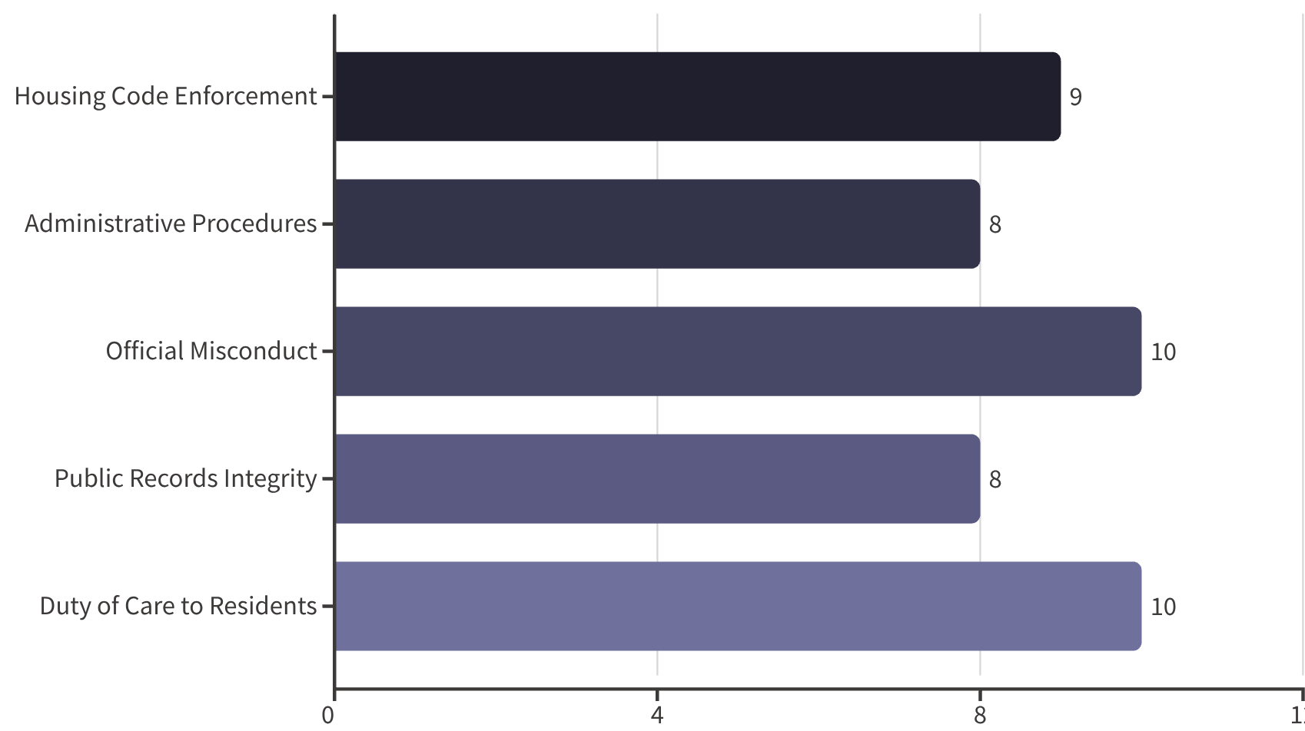
Analysis of Regulatory Failures and Legal Violations
The Addison Fire Tragedy reveals multiple levels of regulatory failure and potential legal violations by SDCI officials. These failures extend beyond simple negligence to include potential violations of municipal codes, administrative procedures, and possibly criminal statutes regarding official misconduct.
Official Misconduct Concerns
The apparent falsification of inspection reports and misrepresentation of site visits raises serious questions about potential violations of RCW 9A.80.010, which criminalizes official misconduct by public servants who knowingly commit unauthorized acts in their official capacity. Inspector Rudolph's contradictory claims about property access and the falsified timeline of events could potentially constitute such misconduct.
Housing Code Enforcement Failures
SDCI violated its fundamental mandate to enforce Seattle's Housing and Building Maintenance Code (SMC Title 22), which explicitly requires the department to ensure residential buildings maintain operational garbage disposal systems and clear egress routes. By allowing trash to accumulate in stairwells for weeks despite explicit documentation of these violations, SDCI directly contravened its statutory obligations.
Public Records Integrity Issues
The annotations regarding missing complaints and disappeared notices of violation suggest potential violations of Washington's Public Records Act (RCW 42.56), which prohibits the destruction or alteration of public records. If records were deliberately removed from the Seattle Services Portal to obscure SDCI's negligence, this would constitute a serious breach of public trust and potentially violate state law.
Administrative Procedure Violations
The systematic "Administrative Closure" of complaints without proper inspection or resolution represents a clear violation of SDCI's own procedural requirements. Department procedures mandate verification of compliance before complaint closure - not simply clearing the administrative backlog without addressing hazards.
Regulatory Violations Severity Level
The most egregious failure, however, was SDCI's breach of its fundamental duty to protect public safety. By ignoring explicit warnings from the Seattle Fire Department - professionals specifically trained to identify fire hazards - SDCI officials abdicated their most basic responsibility to safeguard residents. This failure was compounded by their subsequent attempts to cover up this negligence through administrative manipulations rather than acknowledging their errors and implementing reforms to prevent future tragedies.

Slide 8
Pattern of Systemic Negligence Beyond the Addison Incident
The Addison Fire Tragedy cannot be dismissed as an isolated incident of oversight or individual error. Evidence from the Seattle Services Portal suggests a troubling pattern of continued complaints and unresolved issues at the property both before and after the fire, indicating a systemic failure of regulatory enforcement:
Pre-Fire History (2016-2019)
Post-Fire Continuation (2020-2025)
Broader Institutional Failures
Records indicate multiple fire incidents and complaints prior to the January 2020 fire. The portal annotations specifically note "2016-2019 COMPLAINTS MISSING," suggesting a longer history of unaddressed problems and potentially deliberate removal of documentation that would establish a pattern of negligence.
Far from resolving issues after the January 2020 fire, the Seattle Services Portal documents continued problems and complaints at the Addison through 2025, demonstrating SDCI's ongoing failure to ensure lasting compliance with housing codes:
The handling of the Addison complaints reflects deeper institutional problems within SDCI's enforcement processes that endanger residents throughout Seattle:
Prioritization of administrative efficiency (closing complaints) over substantive resolution
Multiple complaints throughout 2020-2022 regarding similar sanitation issues
November 3, 2019: Fire Department response for "Fire in Building"
Failure to coordinate effectively with other agencies like the Seattle Fire Department
February 18, 2023: Another "Fire in a Highrise" incident requiring emergency response
Multiple complaints regarding unsanitary conditions dating back to at least 2018
Inadequate follow-up mechanisms to ensure compliance with notices of violation
Recurring elevator malfunctions and security concerns repeatedly reported
Ongoing housing code violations through 2025 with minimal enforcement
Apparent lack of consequences for property managers who repeatedly violate codes
This pattern demonstrates that the January 2020 fire was not an anomaly but rather the predictable consequence of a broken enforcement system. The continued problems at the Addison after the fire further illustrate SDCI's institutional resistance to meaningful reform even after a catastrophic failure that required a massive emergency response. Without fundamental changes to SDCI's approach to code enforcement, similar preventable tragedies remain likely at residential properties throughout Seattle.

Slide 9




Conclusions and Accountability Recommendations
The Addison Fire Tragedy represents a catastrophic failure of government oversight with direct implications for public safety. The evidence presented in this case study demonstrates that this disaster was entirely preventable and resulted directly from SDCI's systematic negligence and subsequent attempts to cover up that negligence. The following conclusions are inescapable:
Independent Investigation
Immediate appointment of an independent investigator with subpoena power to examine all SDCI records related to the Addison case, including interviewing all involved personnel under oath
SDCI repeatedly ignored explicit warnings from both tenants and the Seattle Fire Department about severe fire hazards at the Addison on 4th Apartments
Administrative Accountability
Inspector Stephen Rudolph and other SDCI officials systematically closed complaints without proper inspection or resolution
Disciplinary proceedings against Inspector Stephen Rudolph and any other officials who participated in falsifying records or negligent enforcement practices
SDCI officials appear to have falsified records to obscure their negligence after the fire occurred
This pattern of negligence directly endangered residents' lives and necessitated a massive emergency response
Systemic Reform
Similar patterns of enforcement failure have continued at the property through 2025, indicating no meaningful institutional reform
Complete overhaul of SDCI's complaint resolution processes, including mandatory response timelines for fire safety issues and prohibition of administrative closures without verification
Legal Review
Referral to appropriate prosecutorial authorities to evaluate potential criminal charges for official misconduct and falsification of public records
This case demonstrates how bureaucratic indifference and regulatory negligence can directly endanger human lives. The fact that SDCI officials prioritized administrative convenience over public safety, and then apparently attempted to cover up their failures, represents a profound breach of public trust. Without meaningful accountability and structural reform, similar preventable tragedies will continue to occur, not just at the Addison but at residential properties throughout Seattle.
Most critically, this case highlights the urgent need for an independent oversight mechanism for SDCI's enforcement activities. When regulatory agencies fail in their fundamental duty to protect public safety, and then engage in apparent misconduct to hide those failures, external accountability becomes essential. The residents of Seattle deserve a code enforcement system that prioritizes their safety over administrative expediency and institutional self-protection.

